Slide 1
Leveraging HR Data for Strategic Workforce Planning Turning Raw Data into Strategic Business Recommendations
Presented by: Oladimeji Edun
Date: 5th of June 2024.

Slide 2
Introduction
Objective: To demonstrate how HR data analysis can provide actionable insights for improving workforce management and strategic business decisions.
Audience: Non-technical panel members.
Structure:
Key Insights and business outcomes
Data analysis methodology
Recommendations

Slide 3
Overview of the Analysis
Data Source: Public HR dataset from the Office for National Statistics.
Scope: Analysis focuses on employee demographics, turnover rates, and performance metrics.
Goal: Identify key trends and areas for improvement to enhance employee retention and productivity.

Slide 4
Key Insights And Business Outcomes
Insight 1: High turnover rate in R&D department.
Outcome: Potentially higher recruitment and training costs; loss of experienced R&D personnel.
Insight 2: Disparities in performance ratings across departments.
Outcome: Identification of departments needing targeted training programs.
Insight 3: Age and Gender correlation with turnover.
Outcome: Development of retention strategies for at-risk employee groups.

Slide 5
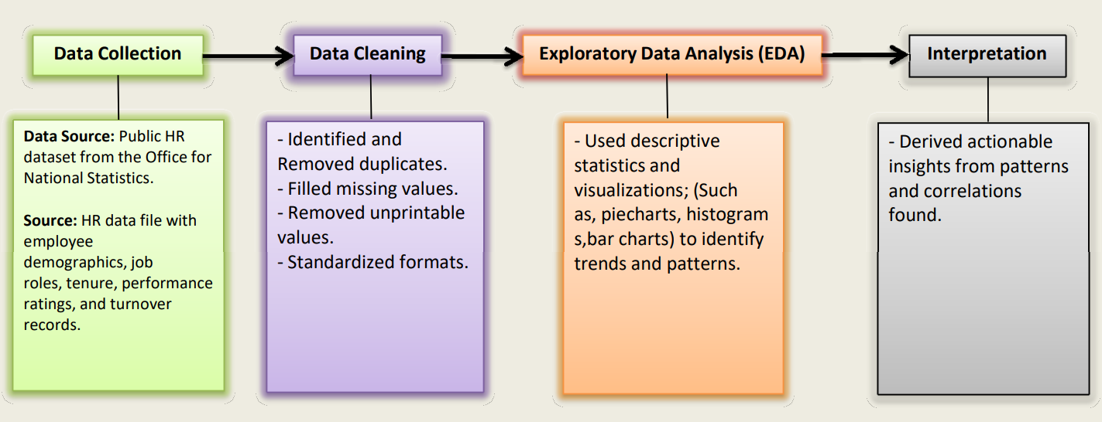
Data Analysis Methodology

Slide 6
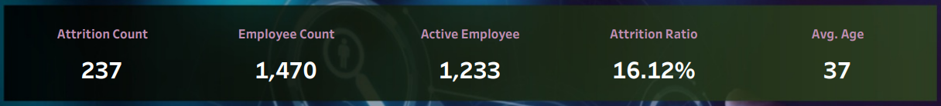
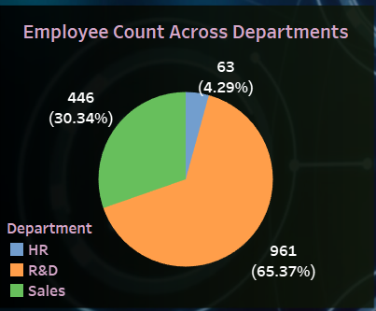
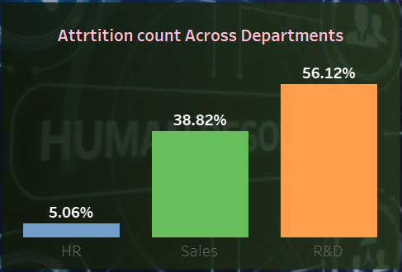
High Turnover in R&D Department
Analysis:
Turnover rate in the R&D department is 34% higher than the company average.
Key Performance Metrics
Implications:
High recruitment and training costs, potential impact on research and development performance.
Visuals:
Charts showing turnover rates across departments.
Notes:
Focused on key Perfoemance Metrics
Research and Development dpt
Attrition count is the turn over rate

Slide 7
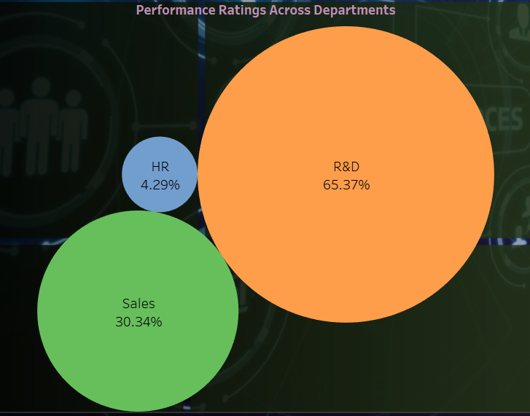
Performance Rating Disparities
Analysis:
Significant variation in performance ratings between departments.
Implications:
Identifies departments that may benefit from targeted training and support.
Visual:
Chart comparing performance ratings across departments.

Slide 8
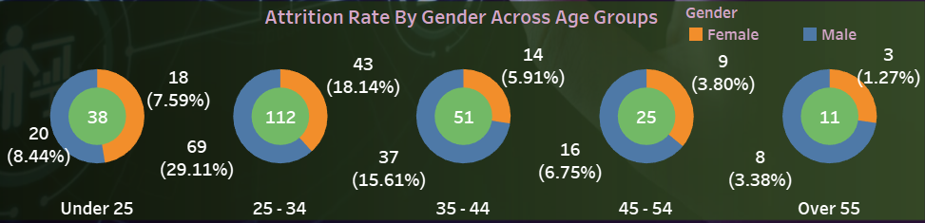
Age and Gender Correlation with Turnover
Visual:
Donut chart showing turnover rates by age and gender.
Implications:
Indicates need for improved onboarding processes and career development opportunities for younger employees.
Analysis:
Higher turnover rates among male employees between aged 25 - 34.

Slide 9
Recommendations
Enhance Retention Strategies
Develop targeted retention programs for R&D department.
Implement mentorship programs for employees with less than 2 years tenure.
Training and Development
Introduce tailored training programs for departments with lower performance ratings.
Regular performance reviews and feedback sessions.
Onboarding and Career Development
Strengthen onboarding processes for new hires.
Create clear career development paths and opportunities for professional growth.

Slide 10
Conclusion
Summary: Effective use of HR data can provide critical insights to improve employee retention, performance, and overall business outcomes.
Next Steps: Implement recommended strategies, monitor their effectiveness, and continue to refine based on ongoing data analysis.

Slide 11
Thank You

